Slide 1
Personalizing RDA Toolkit
Module 7
Notes:
Last updated: March 26, 2024
This module is based on the September 2023 release of the RDA Toolkit.

Slide 2
Create views to change the display of policy statements, examples, Element Reference, and Orientation Guidance Menu
Create bookmarks and notes to quickly navigate to critical or frequently used instructions
View and subscribe to documents created by RDA Toolkit users

Slide 3
Manage Views

Slide 4
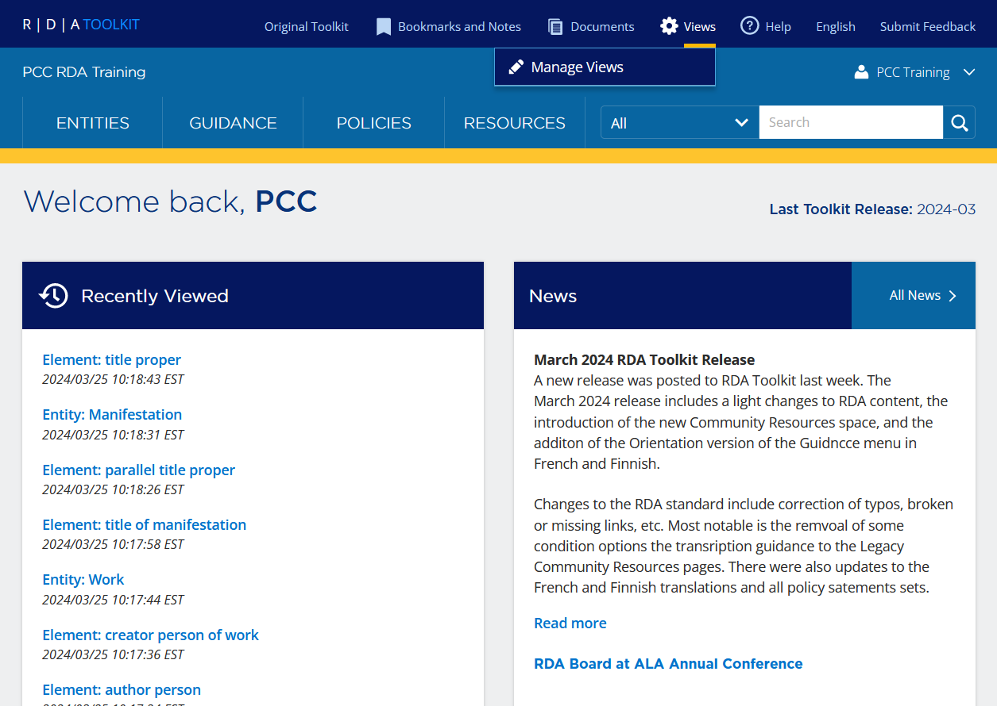
Manage Views
Views are personalizations associated with your profile
May have multiple views to support specific tasks
To create or manage a view, select Views > Manage Views
Notes:
Views are personalizations associated with your profile. Your profile may have multiple views to support specific tasks. For example, you may have one view that displays LC-PCC PSs by default for when you are cataloging books and another view that displays the MLA BPs by default for when you are cataloging scores. To create or manage a view, select “Views” in the dark blue Profile Toolbar and then click “Manage Views”.

Slide 5
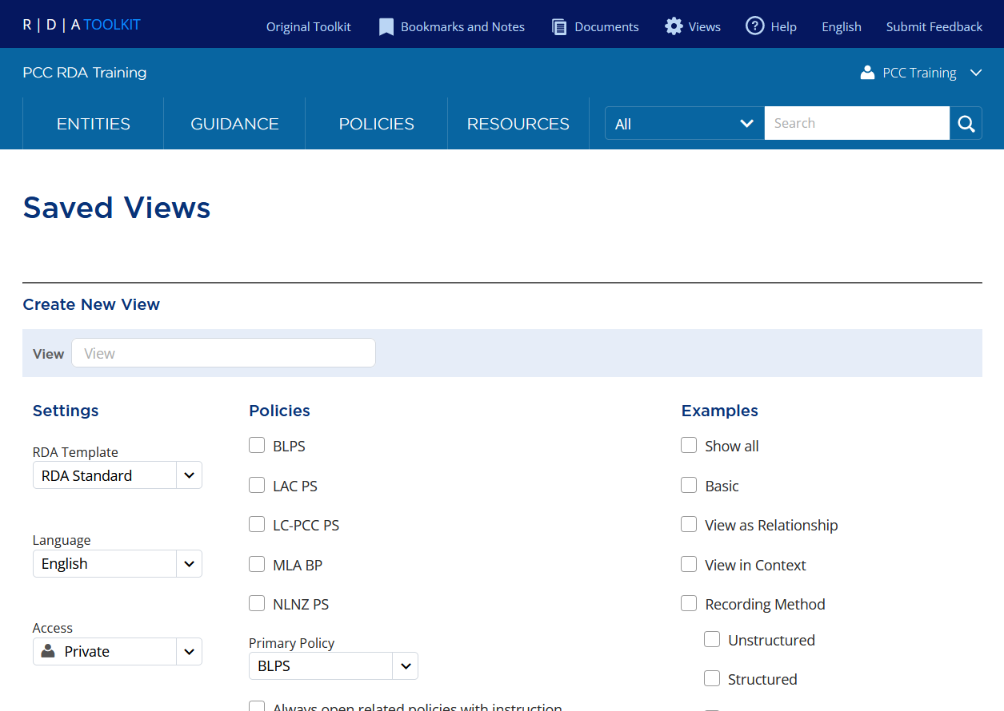
Manage Views
Saved Views
Any saved views display first
Form to create a new view displays at the bottom
Notes:
When you click on Manage Views, you are taken to a page titled “Saved Views”. Any saved views you have display first followed by a solid line and then a blank form to create a new view.

Slide 6
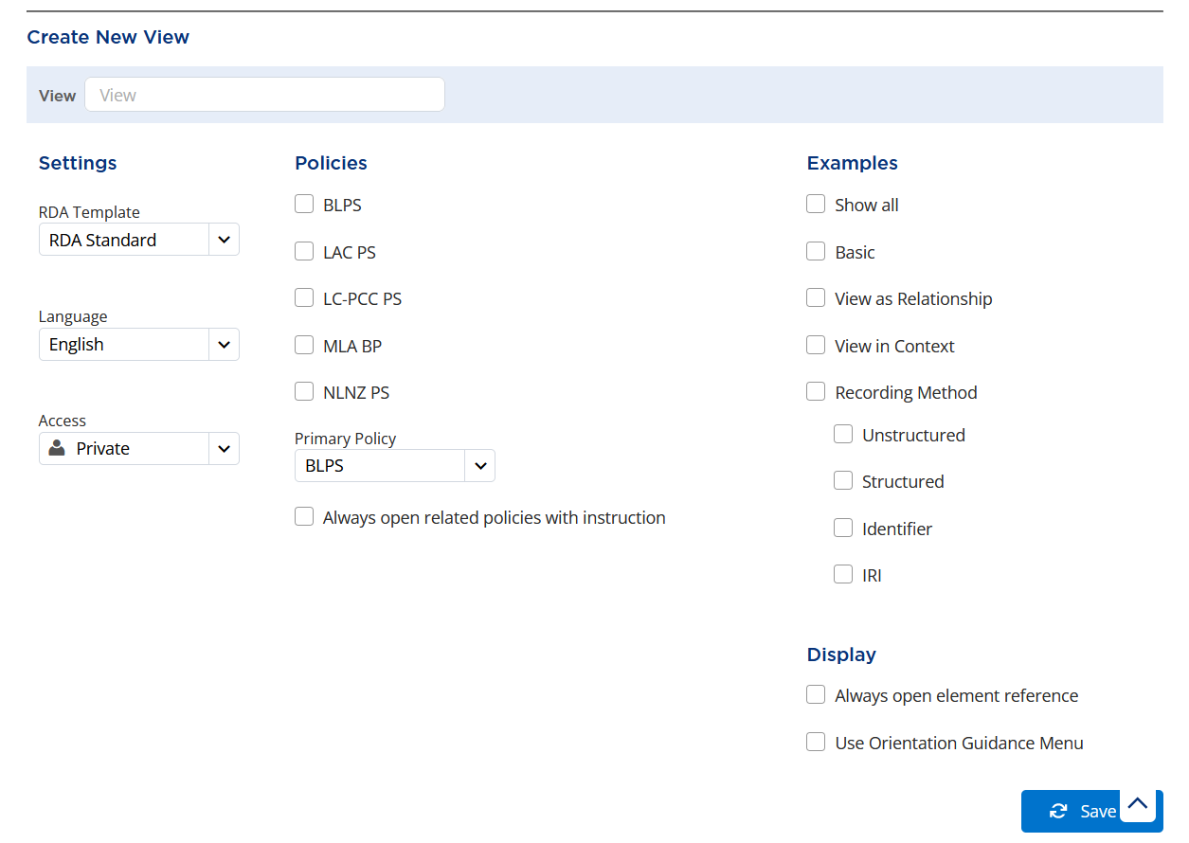

Create New View
Name
Enter a name for the view.
  If you have more than one view, choose a name that will differentiate the views from each other
1
Notes:
To start creating a new view, enter a name for the view in the View box at the top of the form.
LC-PCC PS NAME APPEARS ON CLICK
If you have more than one view, choose a name that will differentiate the views from each other. In this example, since the LC-PCC PSs will be our default policy statements, we named the view LC-PCC PS.

Slide 7
Create New View
Settings
Accept Settings as provided.
  RDA Template
    RDA Standard view is the only template available
  Language
    Language of the user interface
  Access
    Personal profiles will be Private
2
Notes:
In general, accept the three Settings as provided: RDA Template, Language, and Access. The RDA Standard view includes all RDA instructions and is the only template currently available. Like the language options in the Profile Toolbar, there is an option to select the site language as part of the view. As we are logged into our personal profile, the access will be Private, meaning that this view is only available to you.

Slide 8

Create New View
Policies
Select policy statement sets to view.
  BLPS
    British Library Policy Statements
  LAC PS
    Library and Archives Canada Policy Statements
  LC-PCC PS
    Library of Congress-Program for Cooperative Cataloging Policy Statements
  MLA BP
    Music Library Association Best Practices
  NLNZ PS
    National Library of New Zealand Policy Statements
3
Notes:
Select which set or sets of policy statements you want to view. Policy statements are currently available from the British Library, Library and Archives Canada, Library of Congress-Program for Cooperative Cataloging, Music Library Association, and the National Library of New Zealand.
For LC/PCC, select “LC-PCC PS”. Optionally, you may select additional policy statement sets.
Note that any policy statements not selected here will not display at all when using this view. If you may occasionally want to consult a policy statement set, it is best to select it now.

Slide 9
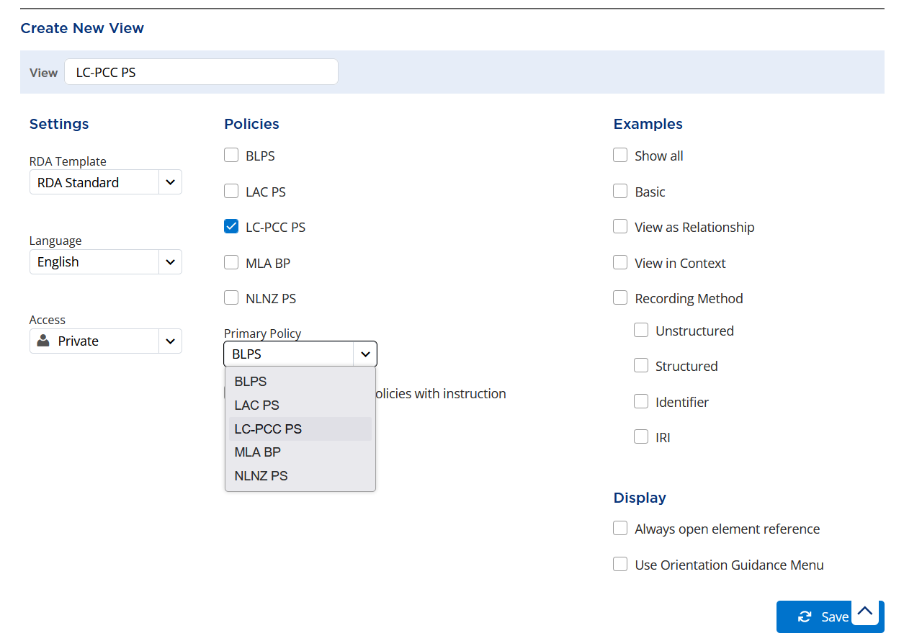
Create New View
Policies
Select a Primary Policy.
  Only one primary policy can be selected for each view
  To view different sets of policy statements:
    Switch the policy statements on an RDA instruction page
    OR
    Create a view for each policy statement set
4
Notes:
From the policy statements you selected, select one to be the Primary Policy. Only one primary policy can be selected for each view. To view different sets of policy statements, switch the policy statement set on an RDA instruction page (i.e., entity, element, guidance, or resource pages) or create a view for each policy statement set and switch among views.
For LC/PCC, select “LC-PCC PS” as your primary policy.

Slide 10

Create New View
Policies
Check Always open related policies with instruction.
  The primary policy selected will always open with related instructions
5
Notes:
Check “Always open related policies with instruction” so your primary policy will always open with the related instructions. This makes it much easier to view the policy statements without having to select them to display every time you log into the Toolkit.

Slide 11

Create New View
Examples
Optionally, select the type of examples to always expand.
  For a description of each example type, see Module 5: Navigating RDA Toolkit
  Recommendation: Show all examples to start. Based on usage, decide if you want to collapse certain types of examples
6
Notes:
Optionally, select the type of examples to always expand. A description of each example type was covered in the Navigating RDA Toolkit module. It is recommended that you start by showing all examples. As you use the RDA Toolkit, you may decide that there are certain types of examples that you don’t want to see and may decide not to expand.
Note that regardless of the options you select in your view, some examples may not automatically expand, but you can expand them by clicking in the Example box.

Slide 12

Create New View
Display
Check Always open element reference.
  Always expanding Element Reference makes it easy to see:
    Range for relationship elements
    Alternate labels
    MARC 21 alignments
7
Notes:
Check “Always open element reference”. This makes it easy to see the range for relationship elements, alternate labels, and, if there are any, MARC 21 alignments.

Slide 13
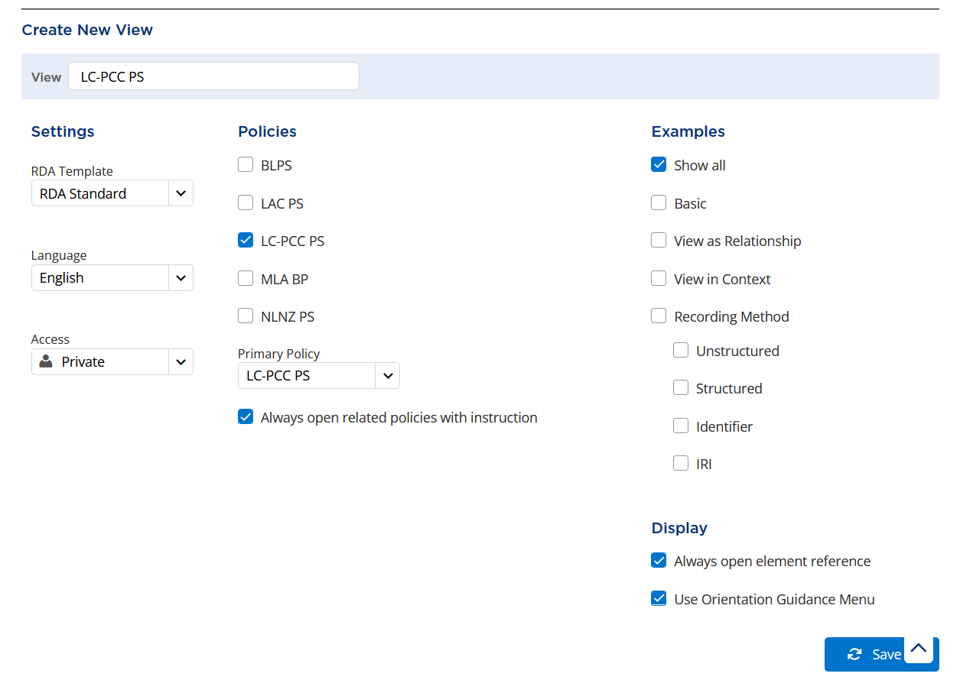
Create New View
Display
Optionally, check Use Orientation Guidance Menu.
  Instead of the default alphabetic order for the Guidance menu, topics are arranged under thematic groups:
    About RDA
    Implementation Considerations
    Additional guidelines
8
Notes:
Optionally, check “Use Orientation Guidance Menu”. This option, which was introduced in the September 2023 release of the RDA Toolkit, arranges topics in the Guidance menu thematically instead of alphabetically. The thematic groups are "About RDA", "Implementation Considerations", and "Additional guidelines".

Slide 14
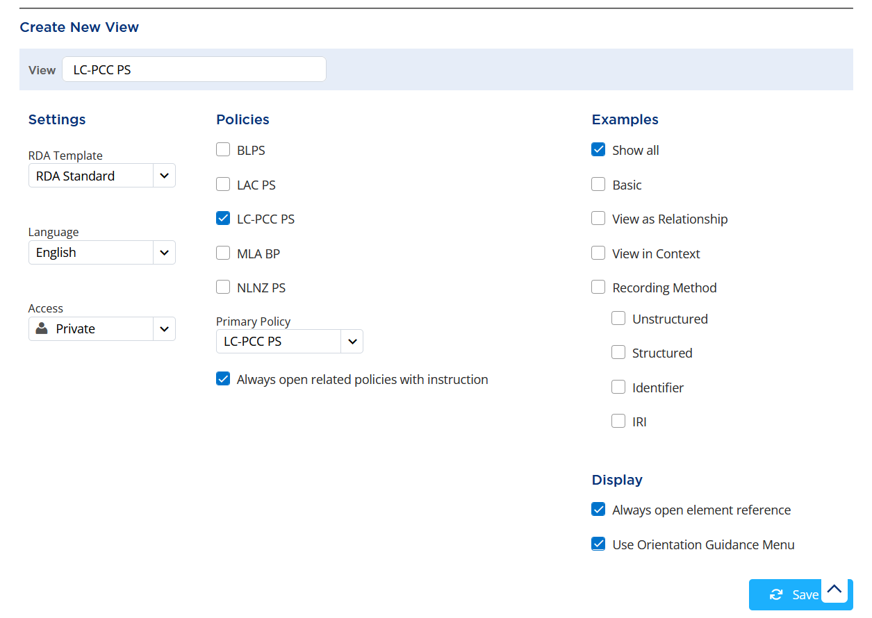
Create New View
Save
To save the view, click Save.
9
Notes:
To save the view, click “Save”.

Slide 15
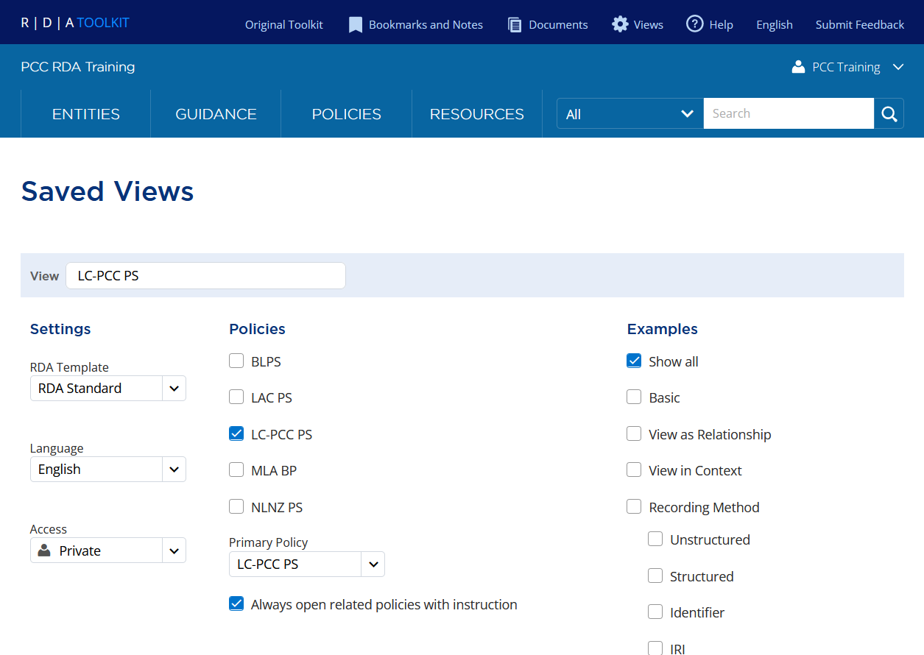
Create New View
Saved Views
After saving the view, it appears under Saved Views
Saved views can be updated at any time
Notes:
After saving a view, it appears under Saved Views and can be updated at any time.

Slide 16
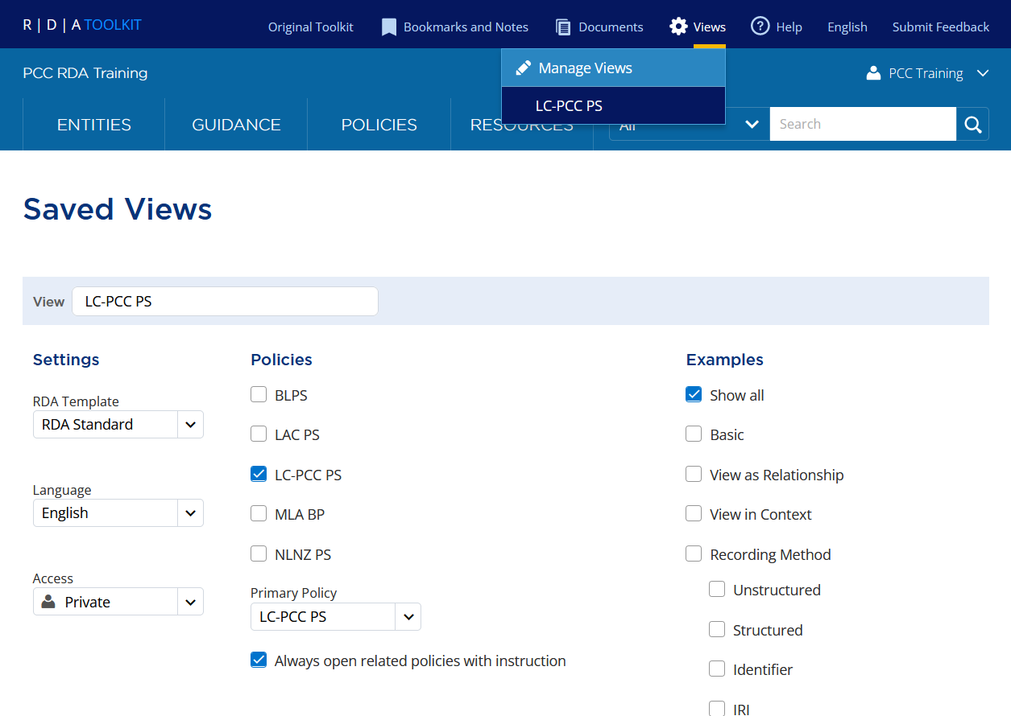
Create New View
Select View
To begin using the view, select Views > [view name].
10
Notes:
Although the view was saved, it is not actually being used in the RDA Toolkit. To begin using the view, select Views in the Profile Toolbar and then the name of the view, in this case “LC-PCC PS”.

Slide 17
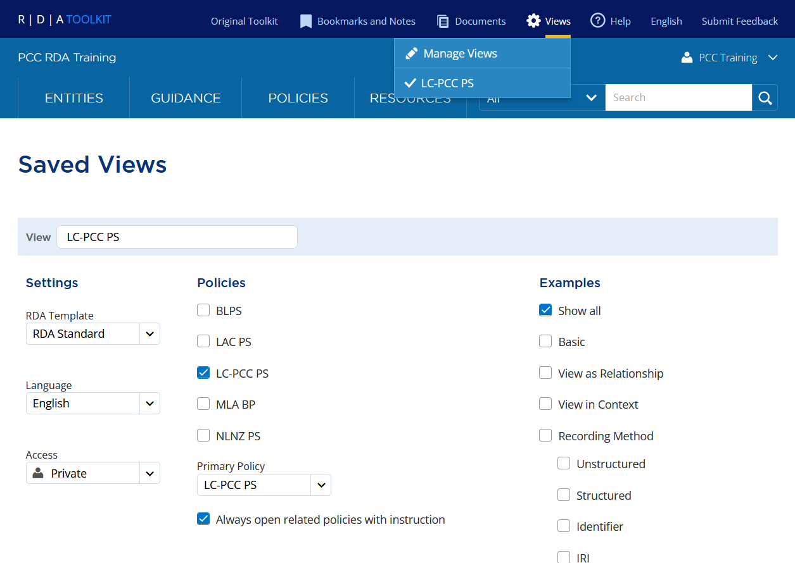
Create New View
Select View
Check mark appears next to selected view
Notes:
After selecting a view, a check mark appears next to it.

Slide 18
Bookmarks and Notes

Slide 19
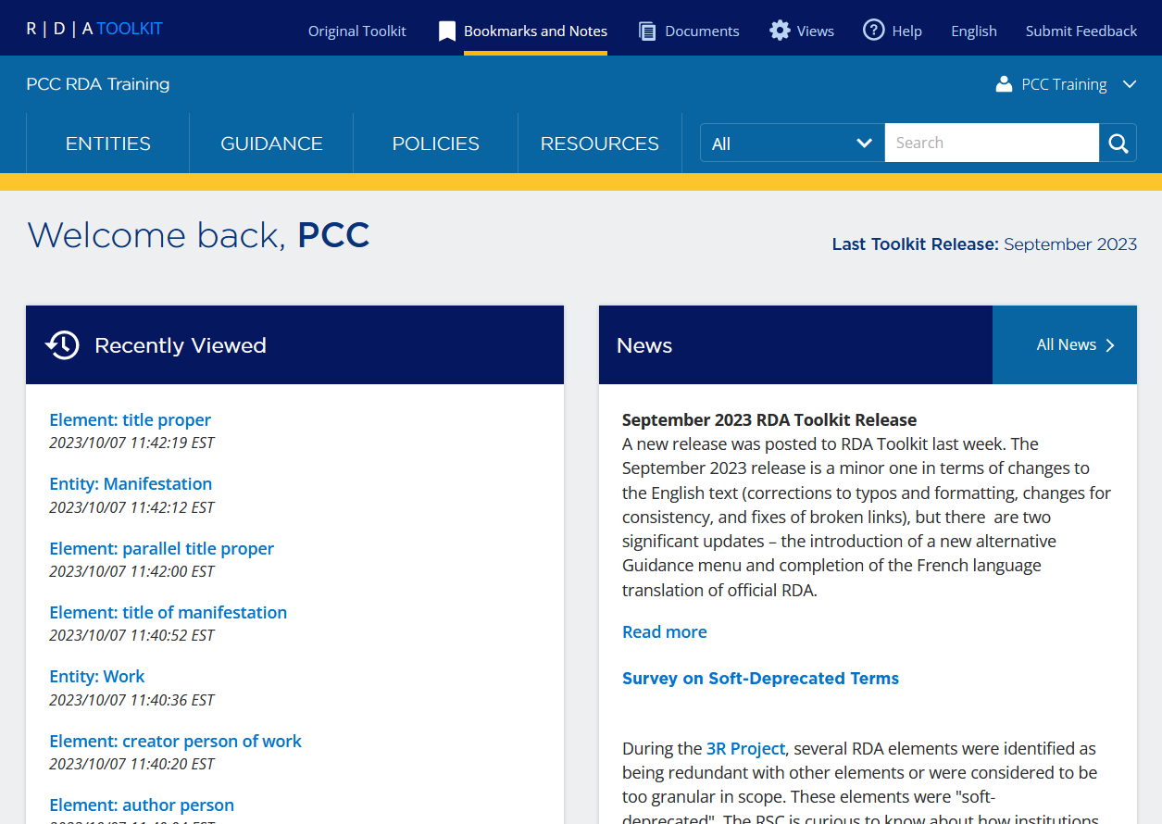
Bookmarks and Notes
Bookmark
  Provides a link to a place in the RDA Toolkit
  Marks that place with the bookmark symbol ( )
  For your use only
Note
  Similar to a bookmark, but allows you to write text that displays when you hover over the note icon ( )
  May be shared locally
Notes:
A bookmark provides a link to a place in the Toolkit and marks that place with the bookmark symbol. They make it easy for you to mark specific content in the Toolkit that you want to be able to easily reference later. Bookmarks are tied to your user profile so only you can see them.
A note is similar to a bookmark, except that it allows you to write text that displays when you hover over the note icon. Notes may be shared locally with other RDA Toolkit users at your institution.

Slide 20
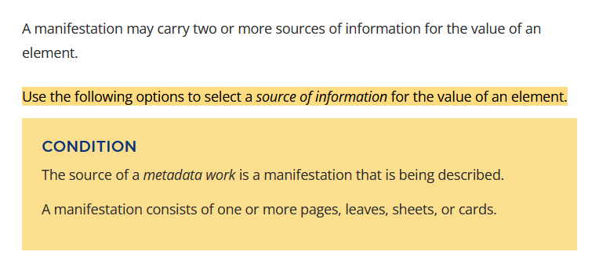
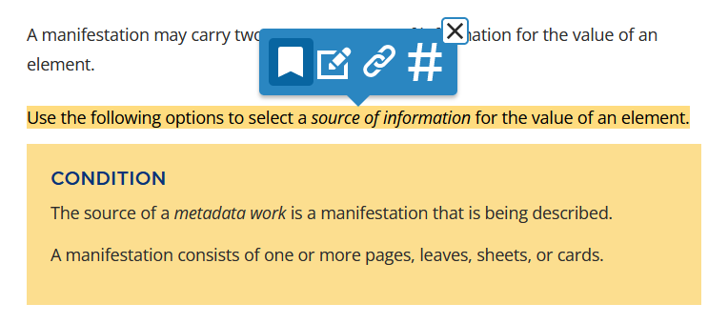

Create a Bookmark
Highlight the text you want to bookmark.
In the pop-up toolbar, select the bookmark icon ( ).
Notes:
To create a bookmark, highlight the text you want to bookmark.
In the pop-up toolbar, select the bookmark icon, which is on the far left.

Slide 21
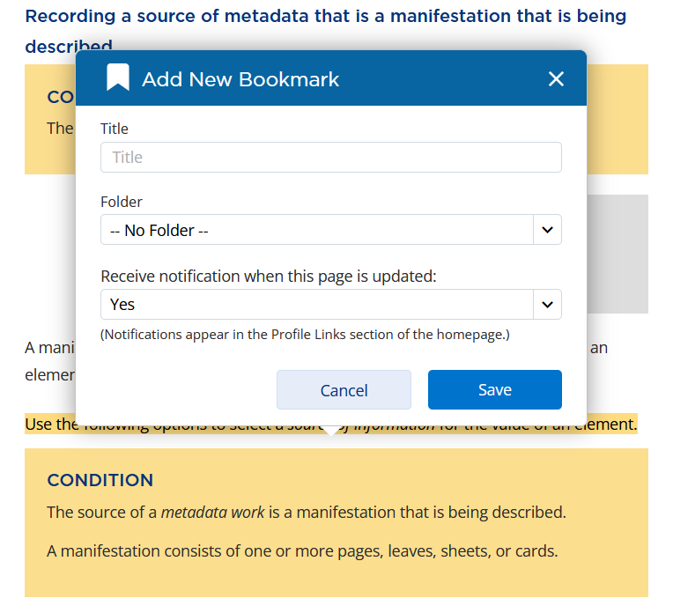
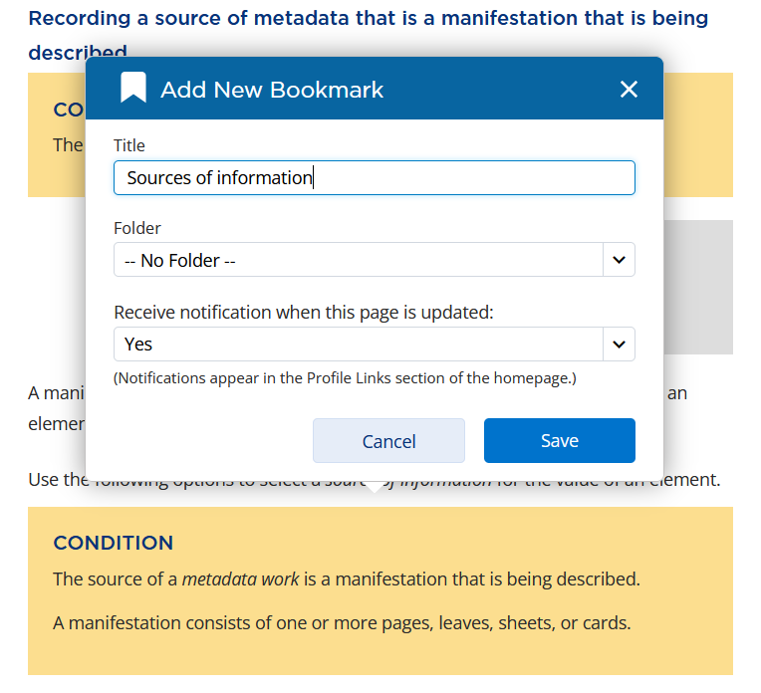
Create a Bookmark
In the Add New Bookmark box:
  Enter a clear, distinctive title.
  Optionally, select a folder.
  Select whether to receive notifications when the page is updated.
  Click Save.
Notes:
In the Add New Bookmark box, enter a clear, distinctive title so it is easily identified in your list of saved bookmarks.
TITLE APPEARS ON CLICK
“Sources of information” was chosen as the title for this bookmark. Bookmarks can be organized into folders. If you already have a folder, you can select the folder where you want to save the bookmark. Select whether to receive notifications when the page (not necessarily the text of the bookmark) is updated. Lastly, click Save.

Slide 22
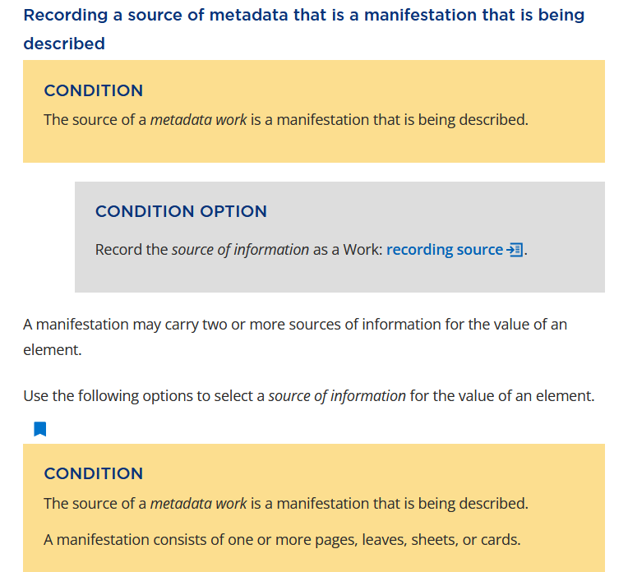
Create a Bookmark
The bookmark icon is added after the highlighted passage
Notes:
After saving a bookmark, the bookmark icon is added after the highlighted passage.

Slide 23
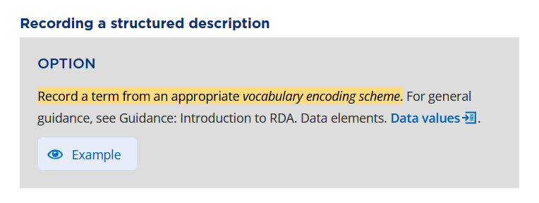
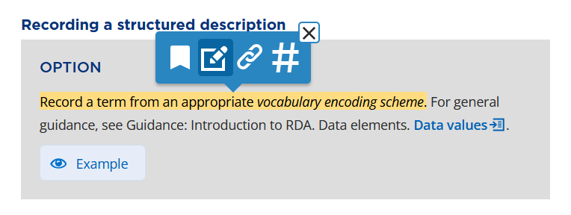

Create a Note
Highlight the text to which you want add a note.
In the pop-up toolbar, select the note icon ( ).
Notes:
To create a note, highlight the text to which you want to add a note.
In the pop-up toolbar, select the note icon, which is second from the left.

Slide 24
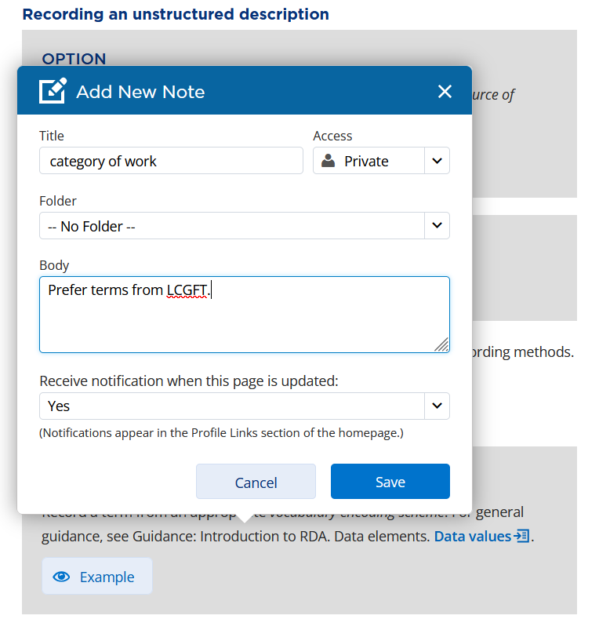
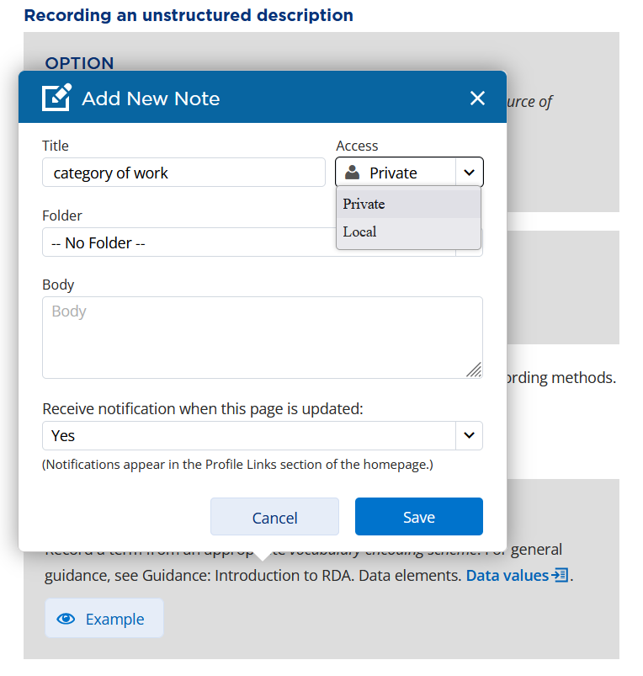

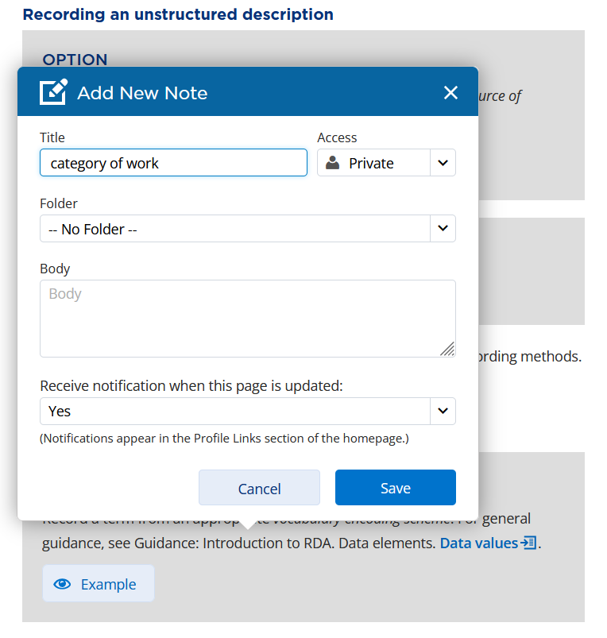
Create a Note
In the Add New Note box:
  Enter a clear, distinctive title.
  Select level of access.
    Private = only you
    Local = your institution
  Optionally, select a folder.
  Enter the text of the note in the body.
  Select whether to receive notifications when the page is updated.
  Click Save.
Notes:
In the Add New Note box, enter a clear, distinctive title so it is easily identified in your list of saved notes.
TITLE APPEARS ON CLICK
In this case, the name of the element, category of work, was chosen as the title of the note.
ACCESS DROP-DOWN MENU APPEARS ON CLICK
Select the level of access. Private means that only you can see the note. Local means that all RDA Toolkit users at your institution can see the note. Similar to bookmarks, notes can also be organized into folders. If you already have a folder, you can select the folder where you want to save the note. Enter the text of the note in the body field.
BODY APPEARS ON CLICK
The text entered in the body will appear when you hover over the note icon. Select whether to receive notifications when the page (not necessarily the text where the note was added) is updated. Lastly, click Save.

Slide 25
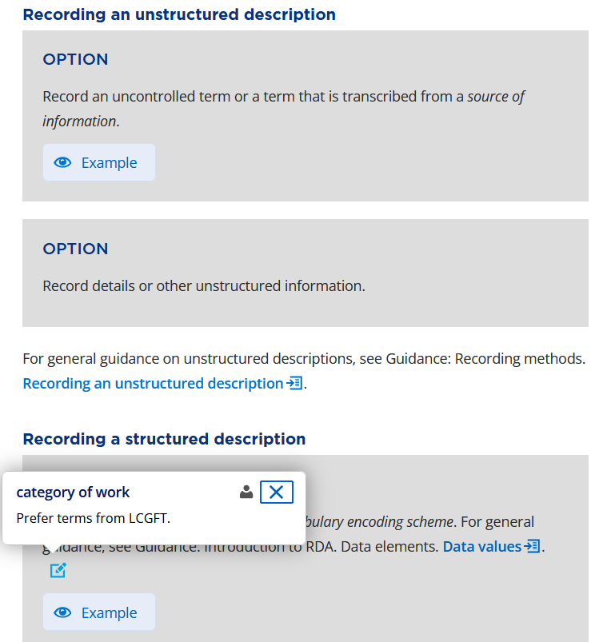
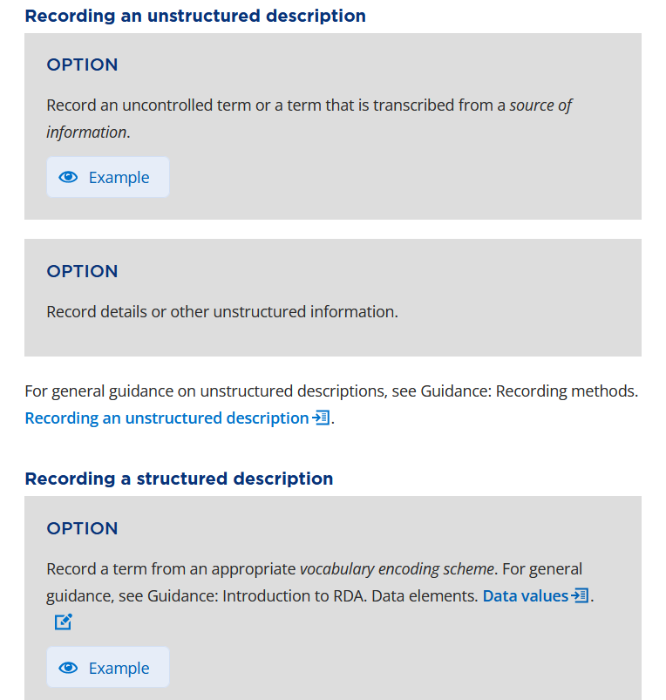
Create a Note
The note icon is added after the highlighted passage
To view the note, hover over the note icon
Notes:
After saving a note, the note icon is added after the highlighted passage. To view the note, …
NOTE APPEARS ON CLICK
… hover over the note icon.

Slide 26
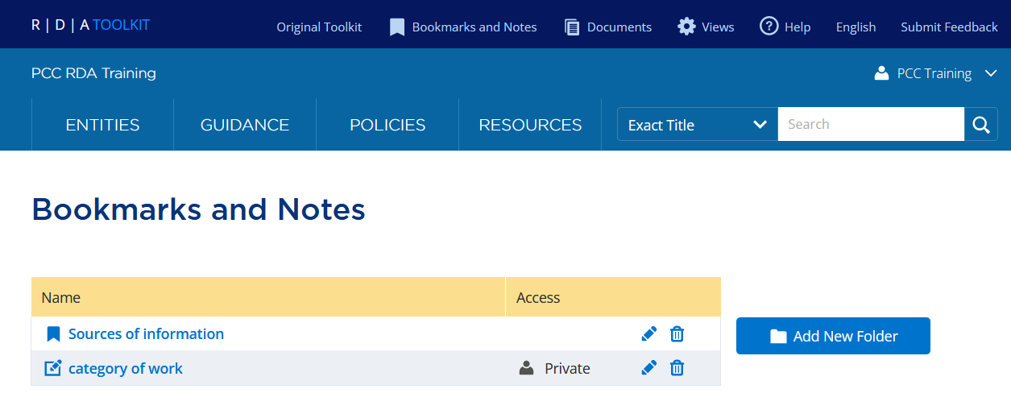
Bookmarks and Notes
To access your saved bookmarks and notes, select Bookmarks and Notes from the Profile Toolbar
From the Bookmarks and Notes page, you can:
  Edit and delete bookmarks and notes
  Organize bookmarks and notes into folders
Notes:
To access your saved bookmarks and notes, select Bookmarks and Notes from the Profile Toolbar. To go to the passage where the bookmark or note was added, click the name of the bookmark or note. To edit a bookmark or note, click the pencil icon. To delete a bookmark or note, click the trash can.
Bookmarks and notes can be organized into folders. First, add a new folder and then edit the bookmark or note to add it to the folder.

Slide 27
Documents

Slide 28
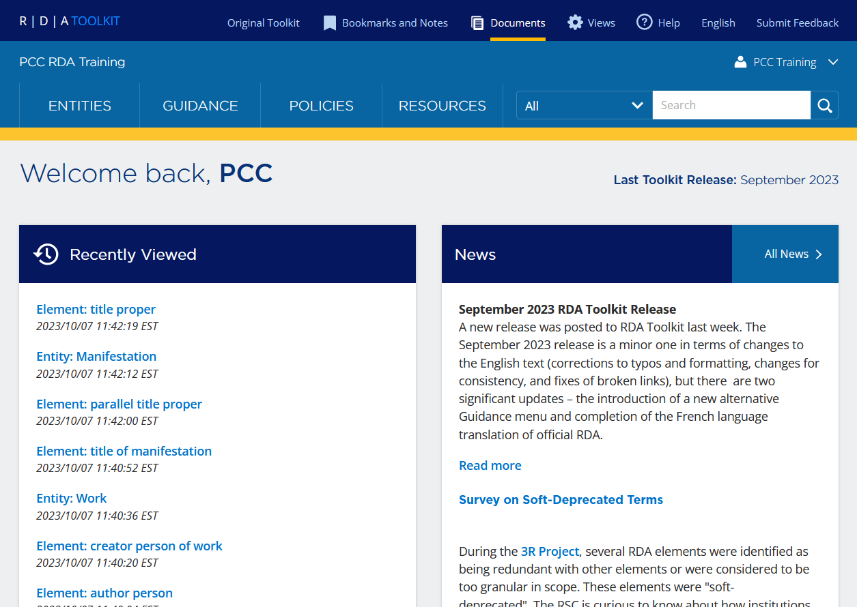
Documents
Allows users to create documents that can be used privately or shared locally, globally, or publicly
Provides access to:
  User-supplied documents
  Managing your own documents and preferences
Notes:
Documents are user-contributed content that are available in the RDA Toolkit. When logged into your profile, you can create documents for your own use or to share with others. Documents can be shared locally with others in your institution, globally with other Toolkit users, or publicly with everyone. You can also view and subscribe to documents created by other Toolkit users.

Slide 29
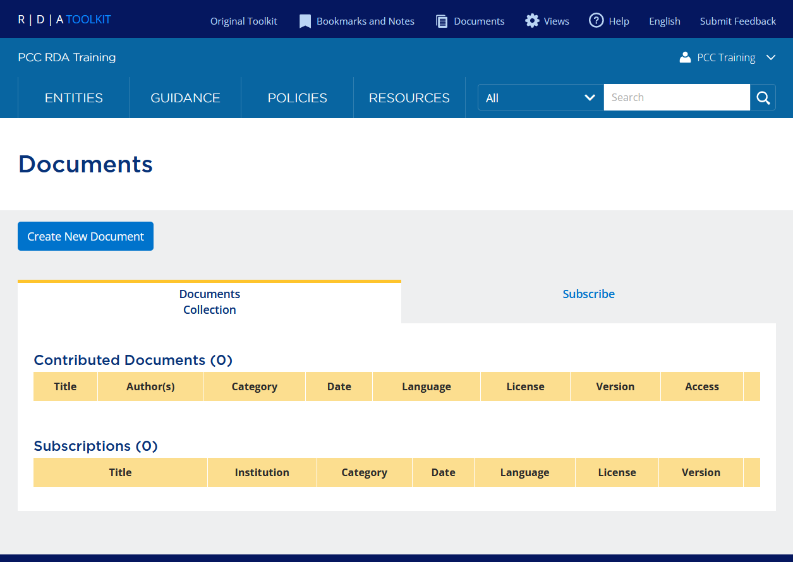
Create a Document
From the Profile Toolbar, select Documents.
From the Documents page, click Create New Document.
1
2
Notes:
To create a document, select “Documents” from the Profile Toolbar.
DOCUMENTS PAGE APPEARS ON CLICK
From the Documents page, click the “Create New Document” button.

Slide 30
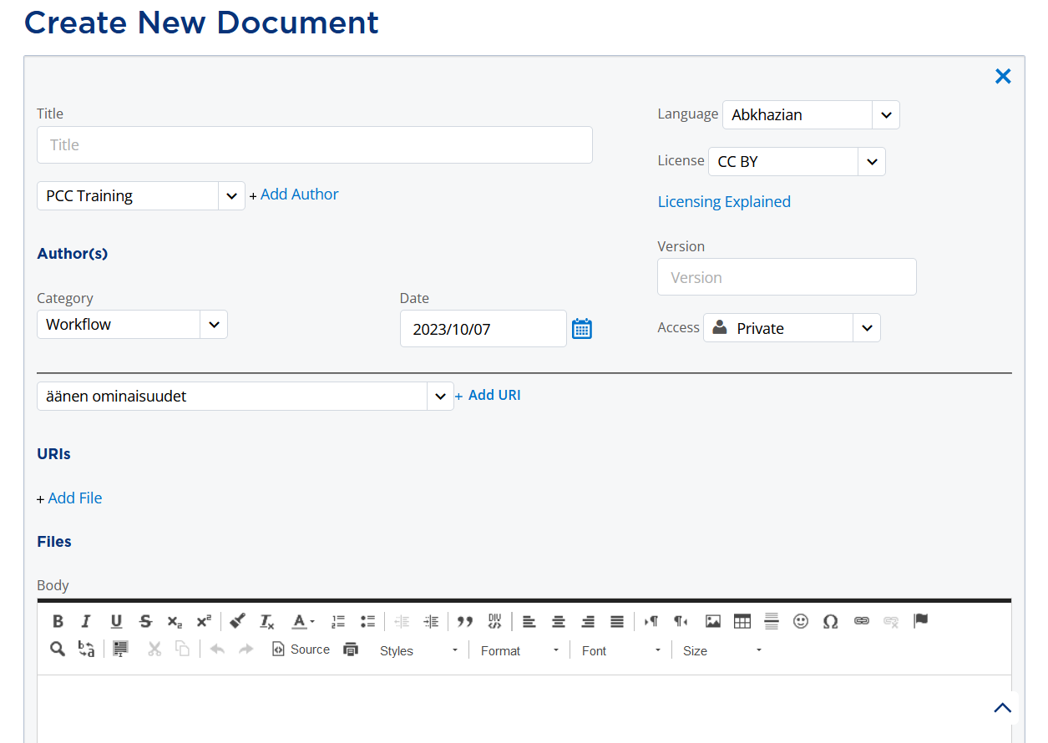
Create a Document
Enter document metadata and select the level of access.
  Enter a Title.
  Add an author.
    Select a name from the drop-down menu and click Add Author.
  Select a Category.
  Select a Language.
  Select a License.
  Select the level of access.
    Private = Only the authors
    Local = Everyone at your institution
    Global = All RDA Toolkit users
    Public = Anyone
3
Notes:
A “Create New Document” page appears for you to create your document. Start by entering document metadata and selecting the level of access.
Enter a Title for your document.
Add an author for your document by selecting a name from the drop-down menu under the Title and then clicking “Add Author”. You can add more than one author so multiple people can edit the document.
Select a Category to indicate the type of document (i.e., Application profile, Local policy, Map, Quick reference, Training material, or Workflow).
In the right column at the top, select a Language to indicate the language of the document.
Select an appropriate Creative Commons License. All documents added to the RDA Toolkit will have a Creative Commons License. Click the “Licensing Explained” link to learn more about the different Creative Commons Licenses.
Optionally, you may enter a Version.
Select the level of access. “Private” means that the document will only be available to the authors of the document. “Local” will allow everyone at your institution to view the document when logged into the RDA Toolkit. “Global” allows all RDA Toolkit users to view your document. “Public” allows anyone to view your document, even if they are not logged into the RDA Toolkit.

Slide 31
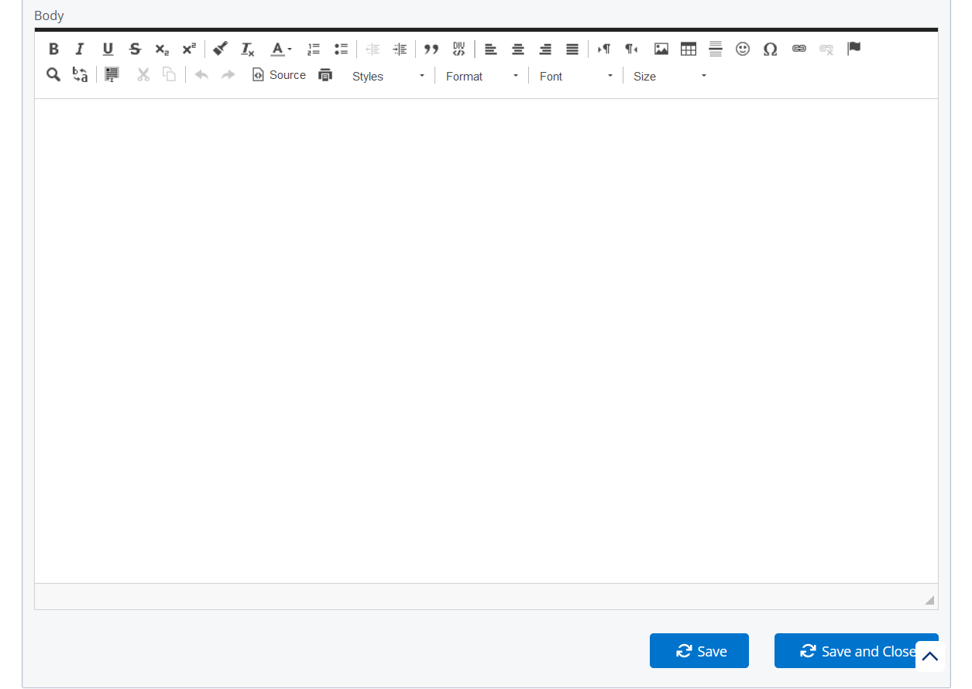
Create a Document
Create your document using the HTML Editor.
  Various buttons are available to assist with formatting and creating links.
  Hover over a button to view its descriptive label.
To save the document and continue editing, click Save. To save and close the document click Save and Close.
4
5
Notes:
Using the HTML Editor, enter the text of your document. There are various buttons available to assist with formatting and creating links. Hover over a button to view its descriptive label.
To save the document and continue editing, click the “Save” button at the bottom of the page. Alternatively, click “Save and Close” to save and close the document and return to the main Documents page. Documents you author will appear under “Contributed Documents”.

Slide 32
View or Subscribe to a Document
From the Profile Toolbar, select Documents.
From the Documents page, click Subscribe.
1
2
Notes:
In addition to contributing documents, you can view and subscribe to documents created by other Toolkit users. Select “Documents” from the Profile Toolbar …
DOCUMENTS PAGE APPEARS ON CLICK
… and from the Documents page, click the “Subscribe” tab.

Slide 33
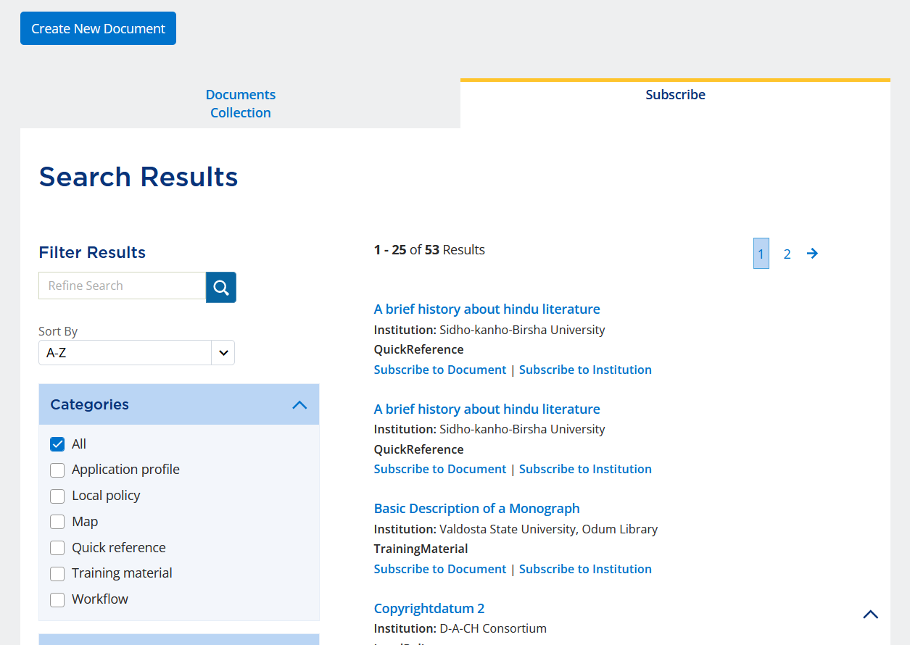
View or Subscribe to a Document
View or subscribe to a document.
  To view a document, click on its title.
  To subscribe to a document click Subscribe to Document.
  To subscribe to all documents from an institution, click Subscribe to Institution.
3
Notes:
Within the Documents Search Results, you can view a document by clicking on its title. Instead of having to scroll through pages of documents to get to a document you regularly consult, you can subscribe to the document by clicking “Subscribe to Document” below the document. Alternatively, if the institution has created multiple documents and you want to subscribe to them all, you can click “Subscribe to Institution” so you don’t have to subscribe to each document separately.
For an example, if we wanted to subscribe to the third result titled “Basic Description of a Monograph”, we can click “Subscribe to Document”.

Slide 34
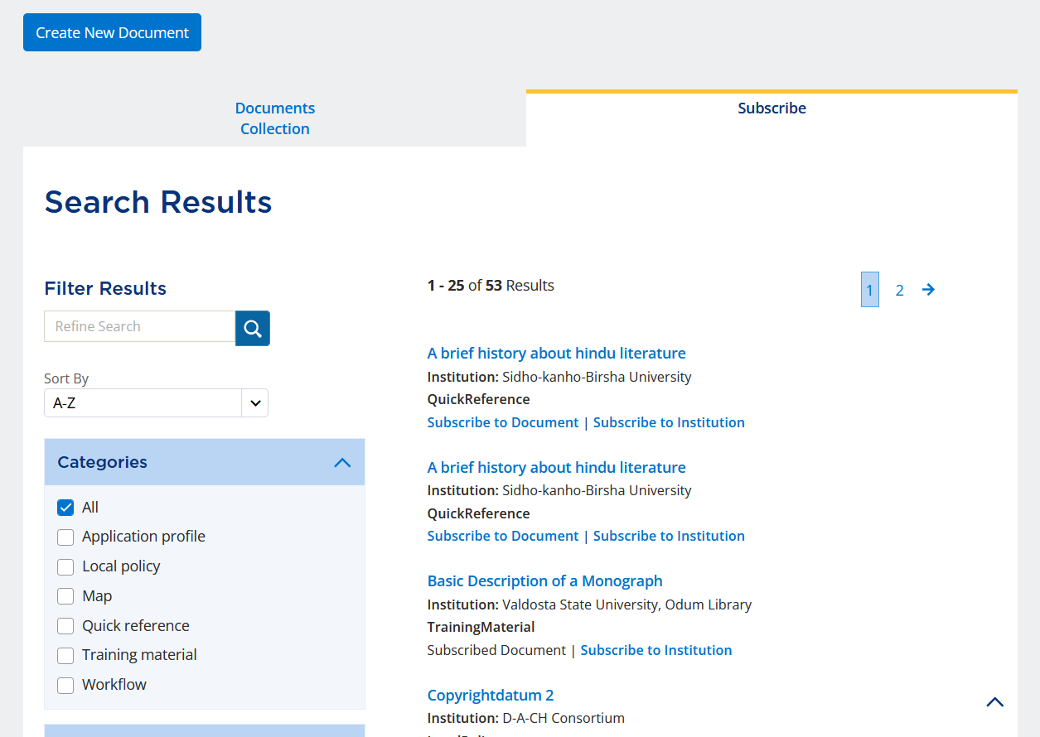
Subscribe to a Document
When subscribed to a document, it will say Subscribed Document.
Notes:
When we subscribe to a document, the text changes from “Subscribe to Document” to “Subscribed Document”.

Slide 35

Subscribe to a Document
Subscribed documents appear under Subscriptions.
4
Notes:
Subscribed documents appear under “Subscriptions” on the “Documents Collection” tab on the Documents page. You can view the document by clicking on the title. To unsubscribe from a document, click the trash can in the far-right column.
Note: This document is used for demonstrate how to subscribe to a document. The inclusion of this document in this training does not imply endorsement by PCC. Further, you are not expected to subscribe to this document.

Slide 36
Views are an important customization.
Views allow you to:
  Select which policy statements you can see
  Always display your default policy statements
  Always open Element Reference and Examples
  Use the Orientation Guidance Menu
Bookmarks and notes allow you to mark text for easy reference later.
Documents allow users to create and share documents in the RDA Toolkit.

Slide 37
Resources
RDA Toolkit Help
  Personalizing RDA Toolkit
  RDA Toolkit Support
RDA Toolkit YouTube Videos
  RDA Toolkit Demonstration
  (September 30, 2022)

